Slide 1

WELCOME!
THE EVENT WILL START SHORTLY
To optimize your viewing experience:
Please submit your questions throughout the event in the chat box (on the bottom right – speech bubble symbol)
Connect with other guests using the chat function. We’d love to hear your thoughts!
We ask everyone to please stay respectful in the chat
A virtual handout with a recording of this will be available – the link will be posted in the chat.
Please mute yourself and turn off your video.

Slide 2


Slide 3


Slide 4


Slide 5


Slide 6
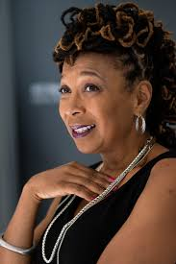
“ When feminism does not explicitly oppose racism, and when anti-racism does not incorporate opposition to patriarchy, race and gender politics often end up being antagonistic to each other, and both interests lose.”
Kimberle Williams Crenshaw

Slide 7

THANK YOU FOR COMING AND PARTICIPATING!
We have posted the link to a virtual handout featuring a recording of the event, further resources and links to the co-sponsoring organizations in the chat
Please help us create even more helpful events (and win OIP swag!) by filling out our short eval survey – also posted in chat
https://shopcommaclub.com/

