Slide 1

Procurement Card Program
Procurement Cards
P-Cards
Travel & Hospitality Expense Cards
THE-Cards
Student Organization Cards
A new WORKS account will provide PCard use as is currently being used by Student Organizations and their Advisors.

Slide 2
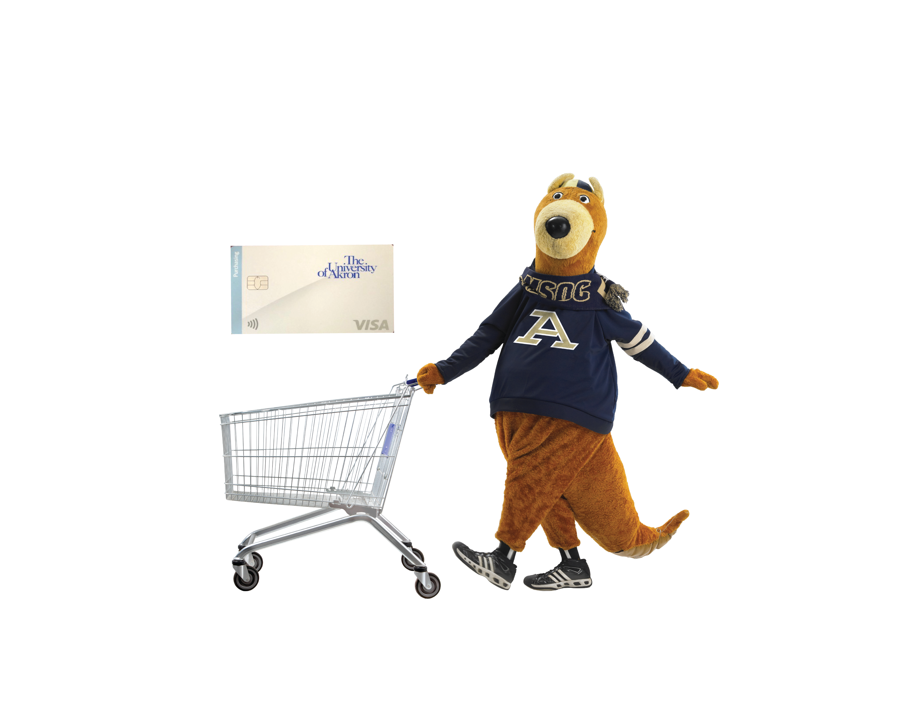
PCard Purchases under $1000 single purchase limit and within $5000 total billing pd. may be purchased as needed.
PCardholder creates Requisition for supplier for single purchases over $1000. Routes for Approval and Budget Check.
PCard transactions feed into WD from Bank of America within 3-5 days of the purchase. PCardholder will need to actively watch for the transactions to appear to verify.
PCard Admin reviews PCard Transactions to verify all transactions have been reconciled.
Follow up with PCardholders if transactions are not verified.
Purchase Order is issued.
PCardholder is notified of the Approval for PCard usage.
PCardholder shops and purchases goods/services from supplier with reference to the PO#
PCardholder uses Verify Procurement Card Transactions function to initiate reconciliation of transactions.
Procurement Card Processing

Slide 3
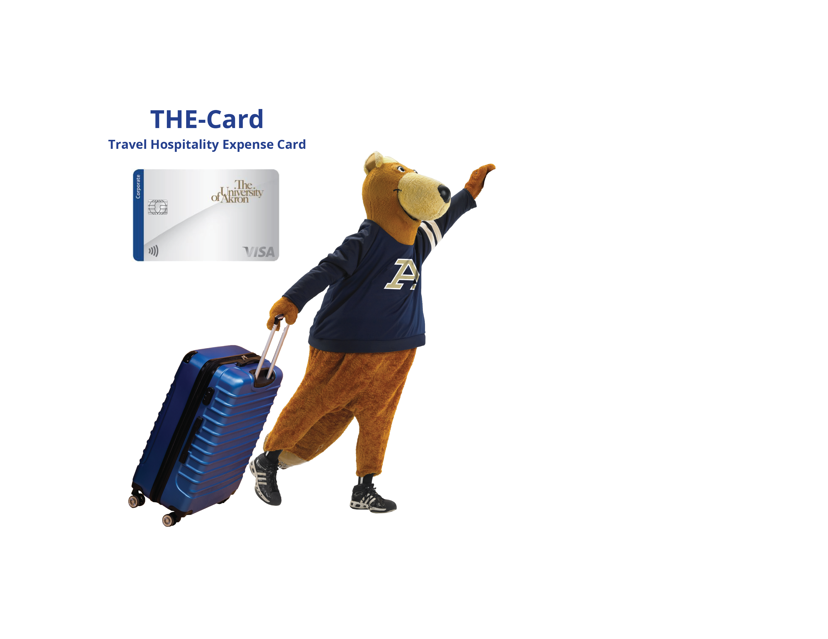
THE-Cardholder creates a Spend Authorization.
Routes for Approval.
THE-Card limits typically set at $3000 Single Purchase/$7000 Billing Period.
THE-Cardholder uses card to book travel for travel-related expenses, or for hospitality event purposes.
THE-Cardholder initiates “Create Expense Report” referencing the Spend Authorization. THE-Card transactions appear within the Expense Report for verification.
IMPORTANT
THE-Card transactions not reconciled within 2 weeks of purchase will severely affect budgets and use of future funds.
THE-Card transactions feed into WD from Bank of America.
THE-Card Processing

Slide 4
Key Take aways
PCards are not used for Punchout Vendors
PCards are used only for good and services
Under $1,000 Single Purchase will not require a WD requisition
THE-Cards are used for all Travel and Hospitality purchases.
THE-Cards users should first create a Spend Authorization
To change Single Purchase and Billing Period card limits, please email PCard@uakron.edu
Verifying transactions no matter if they are P-Card or THE-Card, required within a 2 week period from purchase or severe budget errors will result.

